Slide 1
Linux Commands

Slide 2
Linux or GNU/Linux is a Unix-like operating system (or strictly family of) for computers. An operating system is a collection of the basic instructions that manage the electronic parts of the computer allowing running application programs. Linux is free software, meaning everyone has the freedom to use it, see how it works, change it, or share it.

Slide 3
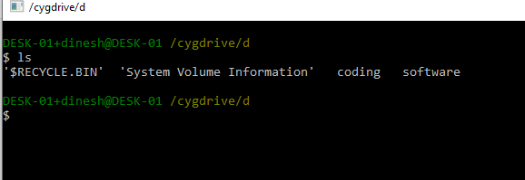
ls
ls
The ls command is used for viewing files, folders and directories.

Slide 4
cd
The cd command - change directory

Slide 5
mv
The mv command - move - allows a user to move a file to another folder or directory.

Slide 6
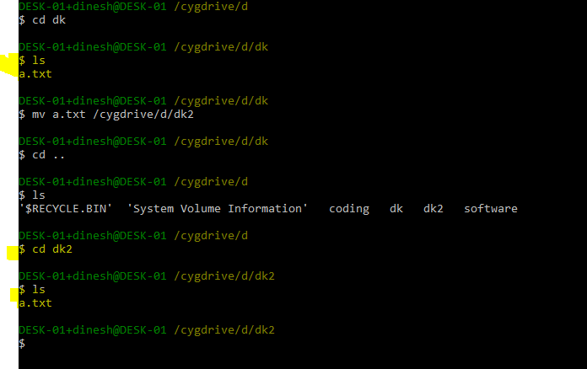

Slide 7
man
The man command - the manual command - is used to show the manual of the inputted command.
Inputting the man command will show you all information about the command you are using.
Example : man cd

Slide 8
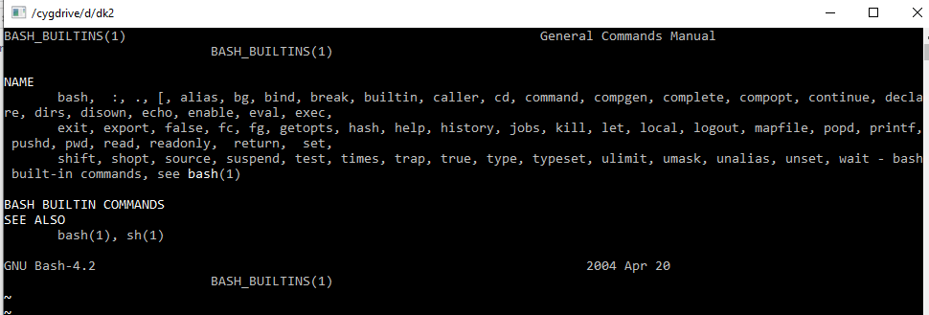

Slide 9
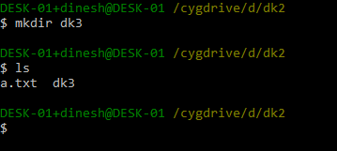
mkdir

Slide 10
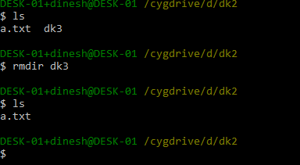
rmdir
The rmdir - remove directory - command allows the user to remove an existing command using the Linux CLI

Slide 11
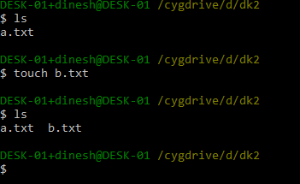
touch
allows users to make files

Slide 12
clear
Clear the screen.

Slide 13
tail
The tail command, as the name implies, print the last N number of data of the given input. By default it prints the last 10 lines of the specified files.

Slide 14
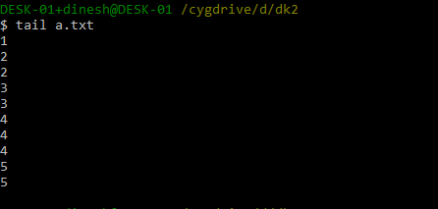

Slide 15
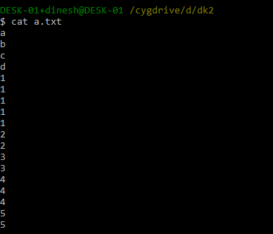
cat
List the contents of file.

Slide 16

echo
Print a string of text.

Slide 17
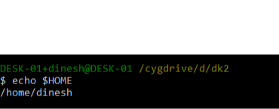

Slide 18
exit
The exit command will close a terminal window.

Slide 19
Thank You

